Slide 1

Unit 7 Assignment - Technology Innovation – Part III
Amon-Ra
Herzing University
BU 620-8 Technology and Innovation

Slide 2


The Innovation
The beauty and cosmetic company, Sephora, has created an innovative technology named Color IQ.

Slide 3
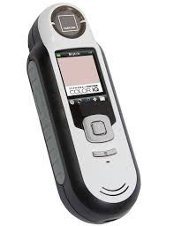
The innovation
Color IQ matches the customer’s skin color to the correct shade of foundation cosmetics within the Sephora product line.

Slide 4


The innovation
Color IQ is only available in store, thus in order for customers to experience Color IQ they must travel to a Sephora location.

Slide 5
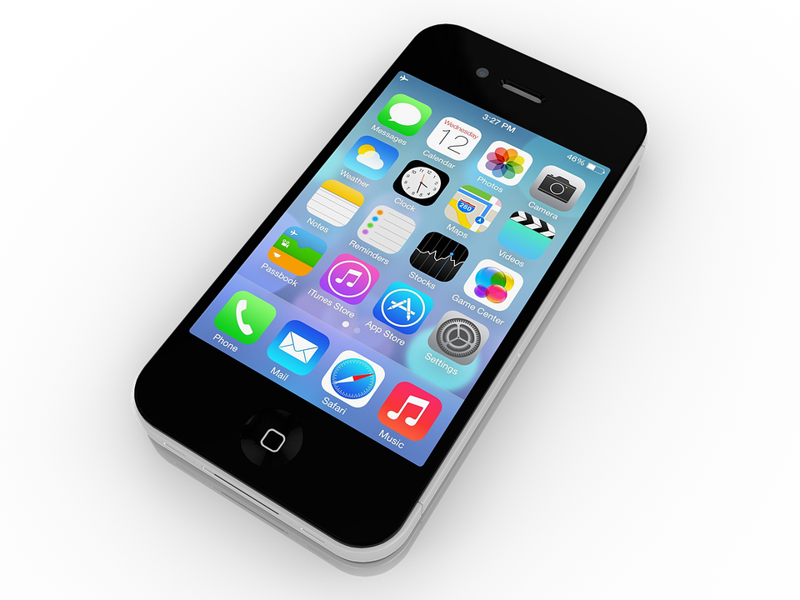
The Innovation
The current innovation involves going mobile to create convenience and expand the availability of Color IQ.

Slide 6

The innovation
Via the creation of a mobile app, Sephora can place the power of Color IQ in the hands every smart phone user.

Slide 7
Innovation type
This innovation is focused on areas of service and channels.
“Service innovations ensure and enhance the utility, performance, and apparent value of an offering. They make a product easier to try, use, and enjoy.” (Keeley, Pikkel, Quinn, & Walters, 2013)

Slide 8
Process selection
“Channel innovations encompass all the ways that you connect your company's offerings with your customers and users. Skilled innovators in this type often find multiple but complementary ways to bring their products and services to customers. (Keeley, Pikkel, Quinn, & Walters, 2013)

Slide 9
Steps implement the idea
Select the operating system platforms for the app.
Determine which smart phones cameras meet the minimum specifications of the hand-held Color IQ device.
Test camera capture quality of the selected phones.

Slide 10
Steps implement the idea
Decide if any additional hardware requirements need to be met.
Hire a 3rd party company to develop the app.
Upon install, the app should perform a hardware test to ensure minimum hardware requirements are met.

Slide 11
Steps implement the idea
App should have a feature to login into or create account for the user.
A triple scan should take place and averaged.
The scan average should be saved in the user account and a matching skin tone number from the database returned produced.

Slide 12
Steps implement the idea
Based on the skin tone number the user should be presented with matching products and should have the ability to select and place an online order for desired products.
Upon completion of the app it will process from the development environment, to the staging environment, and finally to the production environment.

Slide 13
Implementation Process selection
The process chosen for implementation was deemed appropriate to ascertain the functions that require replication in the smart phone, and ensure functionality by first developing the product, followed by quality assurance through testing within a staged environment.

Slide 14
Issues encountered during planning, implementation and execution
During the implementation, we encountered logical programming errors, wherein we did not achieve the desired result, yet the code was executing what is was instructed to do.
During the execution, the app did not appear to function though proven to work in the stage environment. It was later discovered that the firewalls were blocking traffic.

Slide 15
Issues encountered during planning, implementation and execution
Additionally, ports on the server were not open to allow the traffic.
Initial configuration of the firewall rules affected traffic bound for other applications and created an outage.

Slide 16
Lessons Learned for future implementations
Ensure that any and all teams involved in an implementation, create an action plan, valid function following execution of the plan.
When and if a configuration change creates and production issue, the changes in the production should be rolled back immediately.

Slide 17
Lessons Learned for future implementations
If an implementation is not validated in the staging environment, it should not proceed to a production deployment.

Slide 18
References
Keeley, Larry & Pikkel, Ryan & Quinn, Brian & Walters, Helen. (2013). Ten types of innovation: the discipline of building breakthroughs. [Books24x7 version] Available from https://prx-herzing.lirn.net/login?qurl=https://library.books24x7.com/toc.aspx%3fbookid=51263
Nussbaum, R. (2018, November 29). We Tested Sephora Pantone's Color IQ System, for a Bright, Evenly Toned Tomorrow. Retrieved from https://stylecaster.com/beauty/sephora-pantones-color-iq-system/
PutanoBen, B. (2019, June 20). 8 Best Practices for Agile Software Deployment. Retrieved from https://stackify.com/deployment-best-practices/.

